Slide 1


Introduction: Recurrence Relations and Analysis of Recursive Algorithms Session No.: 6 Course Name: Design and analysis of algorithm Course Code: R1UC407B Instructor Name: Rakesh Bharati Duration: 50 Min. Date of Conduction of Class:

Slide 2
Learning Outcome
Solve Recurrence relations and Analysis of Recursive Algorithms
Identify best, worst, and average case scenarios.
Dr. Pooja Singh

Slide 3
Session Outline
1 Complexity Analysis of Recursive Algorithms using Substitution method
2 Reflection learning activity
3 Complexity Analysis of Recursive Algorithms using Master Theorem
4 Reflection learning activity
5 Conclusion and post-session activity
Dr. Pooja Singh

Slide 4
Review of the key concepts 1. Complexity Analysis of Non-Recursive Algorithms 2. Analyzing Non-Recursive Algorithms

Slide 5

🔹Conceptual & Engaging “When we solve a problem by breaking it into smaller subproblems of the same type, how can we mathematically represent the total time it takes?” 🔹 Real-Life Trigger Question "If a function calls itself multiple times, how do we predict whether it will finish quickly or take exponential time?” 🔹 Analytical Thinking Question "Suppose an algorithm divides a problem into two smaller problems of half the size each time. How would you express its running time using a mathematical relation?” 🔹 Simple Warm-Up Version "What happens to time complexity when a function calls itself again and again?”

Slide 6



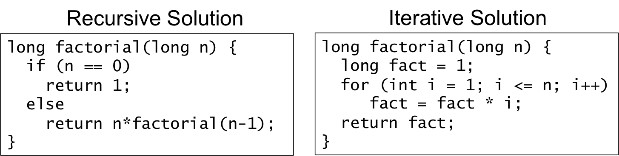

Slide 7

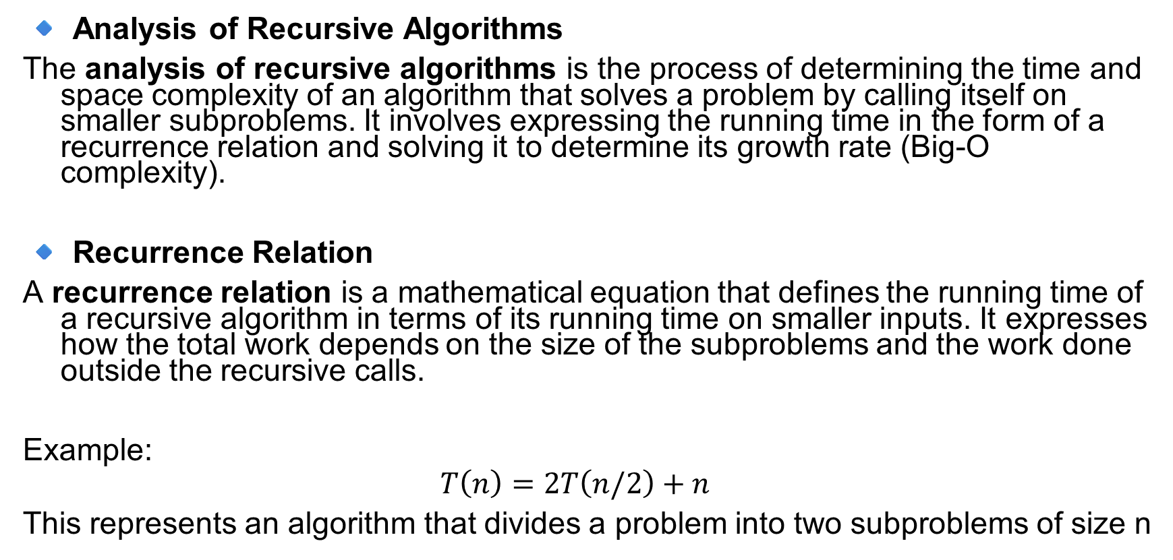
Definition
🔹 Analysis of Recursive Algorithms
The analysis of recursive algorithms is the process of determining the time and space complexity of an algorithm that solves a problem by calling itself on smaller subproblems. It involves expressing the running time in the form of a recurrence relation and solving it to determine its growth rate (Big-O complexity).
🔹 Recurrence Relation
A recurrence relation is a mathematical equation that defines the running time of a recursive algorithm in terms of its running time on smaller inputs. It expresses how the total work depends on the size of the subproblems and the work done outside the recursive calls.
Example:
$$T\left(n\right)=2T\left(n/2\right)+n$$
This represents an algorithm that divides a problem into two subproblems of size n

Slide 8

Analyse Recursive algorithm
Solving Recurrences using
Substitution Method
Recursion tree method
Master Method etc.
Recursive Program
Recurrence Relation
Time complexity

Slide 9

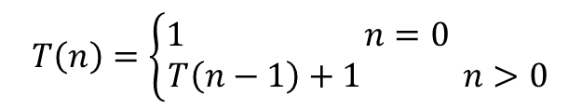

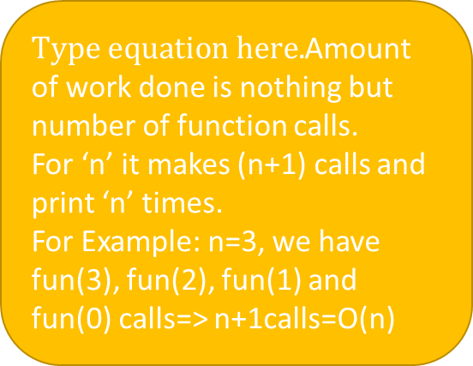
Example1:
$void fun\left(int n\right)$ ------→ T(n)
$$\{$$
$if\left(n>0\right)$
$\{$
$printf(\text{"}\text{Amity}");$ -----→ 1 unit
$fun\left(n−1\right);$ -----→ T(n-1)
$\}$
$\}$ ----------------------------
T(n)=T(n-1)+1
Recurrence relation:
Amount of work done is nothing but number of function calls.
For ‘n’ it makes (n+1) calls and print ‘n’ times.
For Example: n=3, we have fun(3), fun(2), fun(1) and fun(0) calls=> n+1calls=O(n)
$$T\left(n\right)=\left\{\begin{aligned}1 n=0 \\ T\left(n−1\right)+1 n>0\end{aligned}\right.$$

Slide 10


$T\left(n\right)=\left\{\begin{aligned}1 n=0 \\ T\left(n−1\right)+1 n>0\end{aligned}\right.$
Using Back substitution:
$$T\left(n\right)=1+T\left(n−1\right)$$
$=1+\left\{1+T\left(n−2\right)\right\}$
$=1+1+T\left(n−2\right)$
$=1+1+\left\{1+T\left(n−3\right)\right\}$
$=1+1+1+T(n−3)$
……..
$=1+1+1+…+1+T\left(n−n\right)$
$=n+T\left(0\right)$
$=n+1=O(n)$

Slide 11
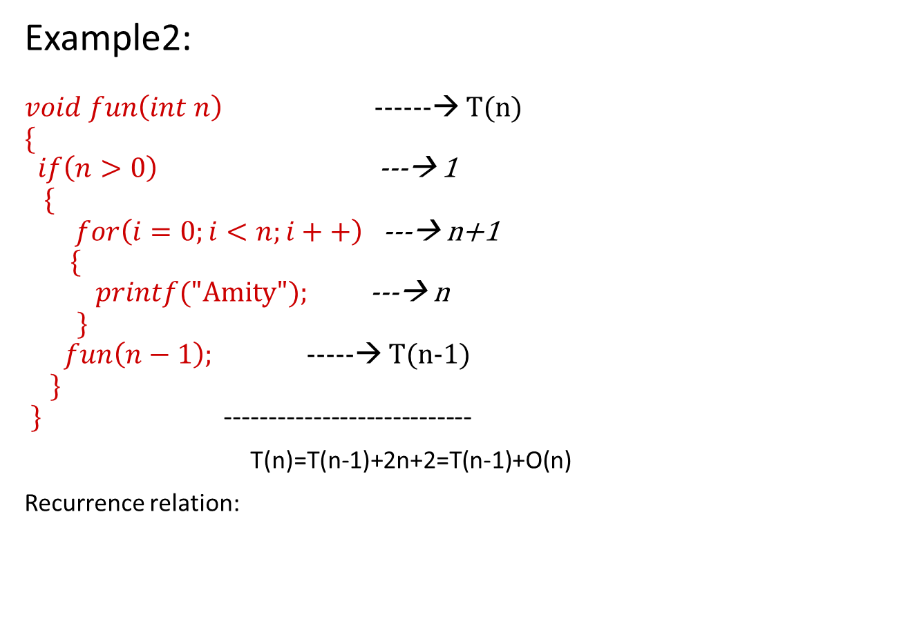
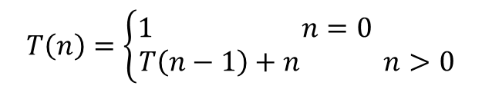
Example2:
$void fun\left(int n\right)$ ------→ T(n)
$$\{$$
$if\left(n>0\right)$ ---→ 1
$\{$
$for\left(i=0;i<n;i++\right)$ ---→ n+1
$\{$
$printf(\text{"}\text{Amity}");$ ---→ n
$\}$
$fun\left(n−1\right);$ -----→ T(n-1)
$\}$
$\}$ ----------------------------
T(n)=T(n-1)+2n+2=T(n-1)+O(n)
Recurrence relation:
$$T\left(n\right)=\left\{\begin{aligned}1 n=0 \\ T\left(n−1\right)+n n>0\end{aligned}\right.$$

Slide 12
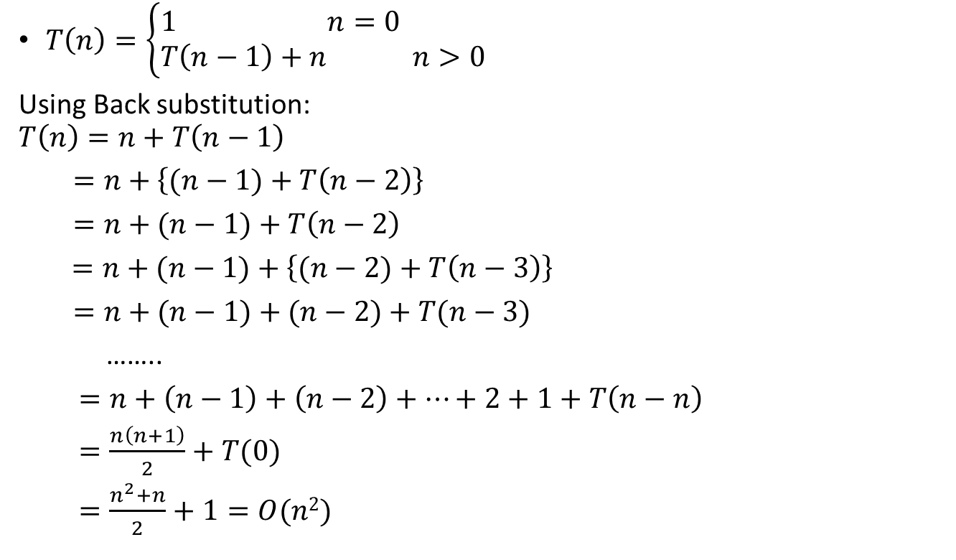
$T\left(n\right)=\left\{\begin{aligned}1 n=0 \\ T\left(n−1\right)+n n>0\end{aligned}\right.$
Using Back substitution:
$$T\left(n\right)=n+T\left(n−1\right)$$
$=n+\left\{(n−1)+T\left(n−2\right)\right\}$
$=n+(n−1)+T\left(n−2\right)$
$=n+(n−1)+\left\{(n−2)+T\left(n−3\right)\right\}$
$=n+(n−1)+(n−2)+T(n−3)$
……..
$=n+\left(n−1\right)+\left(n−2\right)+…+2+1+T\left(n−n\right)$
$=\frac{n\left(n+1\right)}{2}+T(0)$
$=\frac{n^{2}+n}{2}+1=O(n2)$

Slide 13
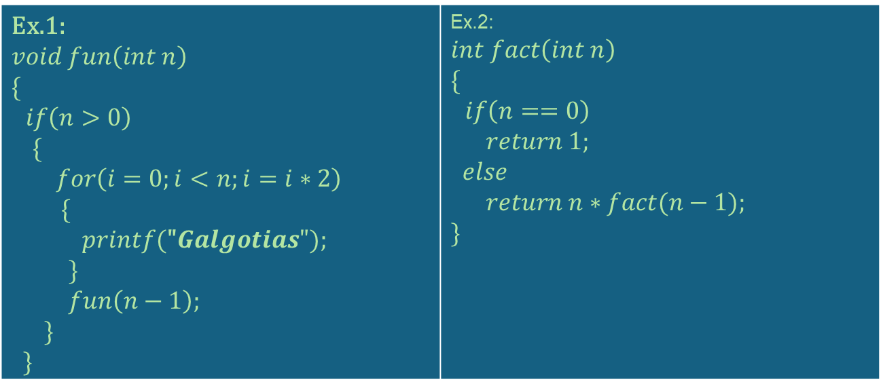
Learning Activity: Pen Paper Activity
Ex.1: $void fun\left(int n\right)$ $$\{$$ $if\left(n>0\right)$ $\{$ $for\left(i=0;i<n;i=i∗2\right)$ $\{$ $printf(\text{"}Galgotias");$ $\}$ $fun\left(n−1\right);$ $\}$ $\}$ | Ex.2: $int fact\left(int n\right)$ $$\{$$ $if\left(n==0\right)$ $return 1;$ $$else$$ $return n∗fact(n−1);$ $\}$

Slide 14
Recurrence Relation
A recurrence relation is an equation that uses recursion to related terms in a sequence or elements in an array. It is a way to define a sequence or array in terms of itself.
It helps in finding the subsequent term (next term) dependent upon the preceding term (previous term). If we know the previous term in a given series, then we can easily determine the next term.
Name of the Faculty: Dr Pooja Singh Program Name: B.TECH

Slide 15
Recurrence Relation:
Ex: Binary search
n
BS (A, l, u, key)
{
mid = (l+u)/2;
if (A[mid] == key)
return mid;
else if (A[mid]<key)
BS (A, mid+1, u, key)
else
BS (A, l, mid-1, key)
}
n/2
n/2
n/4
n/4
Total Time T(n) = T(n/2) +c
Name of the Faculty: Dr Pooja Singh Program Name: B.TECH

Slide 16
Method to solve the Recurrence Relation
Substitution method
Recursive tree method
Master Theorem method
Name of the Faculty: Dr Pooja Singh Program Name: B.TECH

Slide 17

Wooclap activities
Dr. Mili Dhar

Slide 18

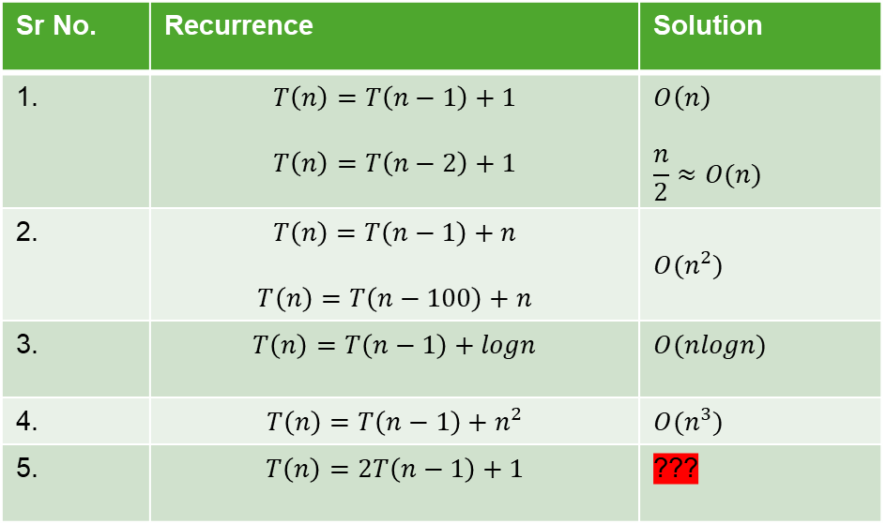
Important results [Decreasing function]:
Sr No. | Recurrence | Solution
1. | $$T\left(n\right)=T\left(n−1\right)+1$$ $$T\left(n\right)=T\left(n−2\right)+1$$ | $$O\left(n\right)$$ $$\frac{n}{2}≈O(n)$$
2. | $$T\left(n\right)=T\left(n−1\right)+n$$ $$T\left(n\right)=T\left(n−100\right)+n$$ | $$O(n^{2})$$
3. | $$T\left(n\right)=T\left(n−1\right)+logn$$ | $$O(nlogn)$$
4. | $$T\left(n\right)=T\left(n−1\right)+n^{2}$$ | $$O(n^{3})$$
5. | $$T\left(n\right)=2T\left(n−1\right)+1$$ | ???

Slide 19
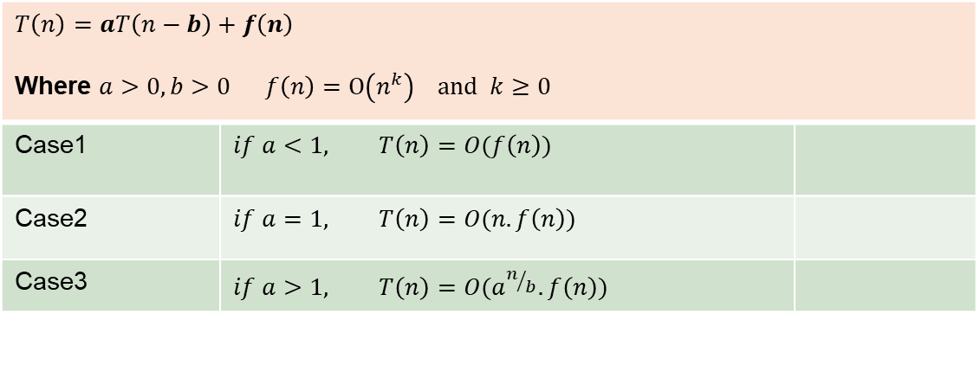
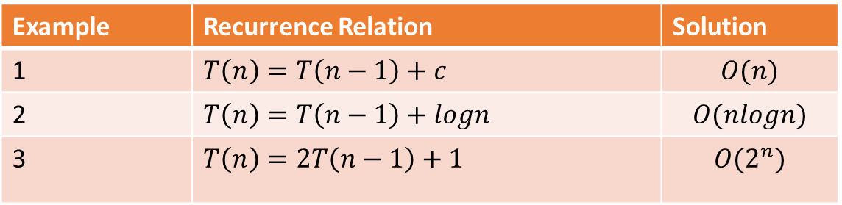
Master Method [Decreasing function]:
$$T\left(n\right)=aT\left(n−b\right)+f\left(n\right)$$ Where $a>0, b>0 f\left(n\right)=O\left(n^{k}\right) and k≥0$
Case1 | $$if a<1, T\left(n\right)=O(f\left(n\right))$$
Case2 | $$if a=1, T\left(n\right)=O(n.f\left(n\right))$$
Case3 | $$if a>1, T\left(n\right)=O(a^{n/b}.f\left(n\right))$$
Example | Recurrence Relation | Solution
1 | $$T\left(n\right)=T\left(n−1\right)+c$$ | $$O(n)$$
2 | $$T\left(n\right)=T\left(n−1\right)+logn$$ | $$O(nlogn)$$
3 | $$T\left(n\right)=2T\left(n−1\right)+1$$ | $$O(2^{n})$$

Slide 20
After completing this section, you will be able to
Analyse recursive algorithms and Solve Recurrence Relations

Slide 21
Post session activities
Q1. T(n) = 5T(n/5) + (n/logn) ^{if n>1}
^{= 1 if n=1}
Q2. T(n) = T(n-2) + 2logn ^{if n>0}
^{= 1 if n=0}
Name of the Faculty: Dr Pooja Singh Program Name: B.TECH

Slide 22
In the next session, Analysis of Solving recurrences – Substitution method will be discussed in detail.
Dr. Pooja Singh

Slide 23
Reflection- How did analyzing this scenario help you understand the importance of Solving recurrences algorithm efficiency?

Slide 24
What was the most interesting concept you learned today? Any doubts or areas requiring further clarification?
Review and Reflection from students

Slide 25
Thank You!!

